Slide 1


Coordination model and digital twins for managing energy consumption and production in a smart grid.
Thesis progress report, February 2024
Philippe Glass
Start date : September 2022
Supervisor : Giovanna Di Marzo Serugendo
Progress report, February 2024

Slide 2


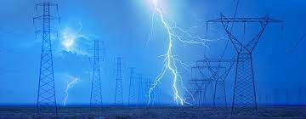




Motivations : the major role of smart-grids in the energy transition
Allow to monitor production/distribution of energy.
Reduce energy costs and energy wastes.
Avoid peaks and shortages.
Decentralise distribution.
Promote renewable energy.
Make distribution more equitable.
Progress report, February 2024

Slide 3



Issue/Research questions/Artefact
The issues:
Grid Edge Devices (which interact with the electric appliances linked to a node) do not yet manage energy exchanges in a collaborative and decentralized way.
It is difficult to manage renewable energy whose production is particularly fluctuating.
The research questions:
Can we design a coordination model and mechanisms that allows Grid Edge Devices to collectively achieve various objectives?
How can we model the notion of digital twins to represent micro-grid entities which exchange and regulate energy at a local level?
How can we integrate into the coordination model a mechanism of Gossip based Federated learning, with an aggregator that the level service can define on the fly?
To what extent can we integrate criteria of social acceptability into Digital Twins behaviours, in decision-making process for electricity transaction and electricity regulation?
The expected artefact :
Coordination model for energy distribution and regulation at the microgrid level.
Progress report, February 2024

Slide 4

State of the art
Sapere model:
(inspired by biology & chemistry)
[Castelli, Gabriella and Mamei, Marco and Rosi, Alberto and Zambonelli, Franco “Engineering pervasive service ecosystems: the sapere approach” (2015)]
[J. L.Fernandez-Marquez. “BIO-CORE : Bio-inspired Self-organising Mechanisms Core ( 2011)]
Models
of coordination
Multi-agent
systems
Holonic architecture at different levels:
[David Menga, ... “A Generic Holonic Control Architecture for Heterogeneous Multi-Scale SmartMicro-Grids..(2014) ]”
Coordination model and digital twins for managing energy consumption and production in a smart grid.
Machine learning
Decentralized Federated Learning:
[Wei Liu, Li Chen, and Wenyi Zhang : “Decentralized Federated Learning: Balancing
Communication and Computing Costs” 2022]
Progress report, February 2024

Slide 5










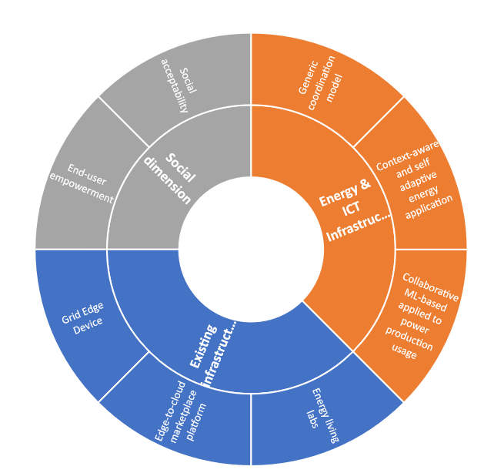
Method: the project ERA-NET LASAGNE ⁽¹⁾
Main axes:
Physical infrastructures
Energy & IT
Social dimension
Progress report, February 2024

Slide 6
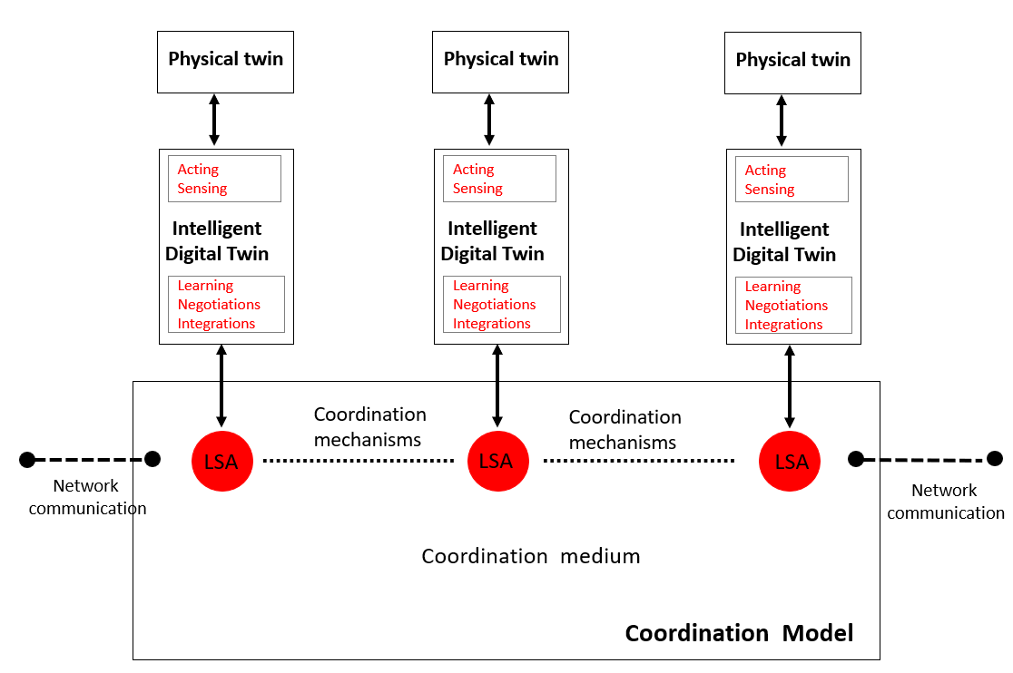
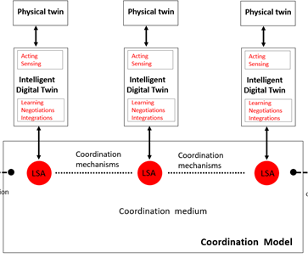
Method: coordination model and platform
Implementation of a coordination platform using:
digital twins,
shared virtual environment (tuple space)
coordination laws.
Progress report, February 2024

Slide 7
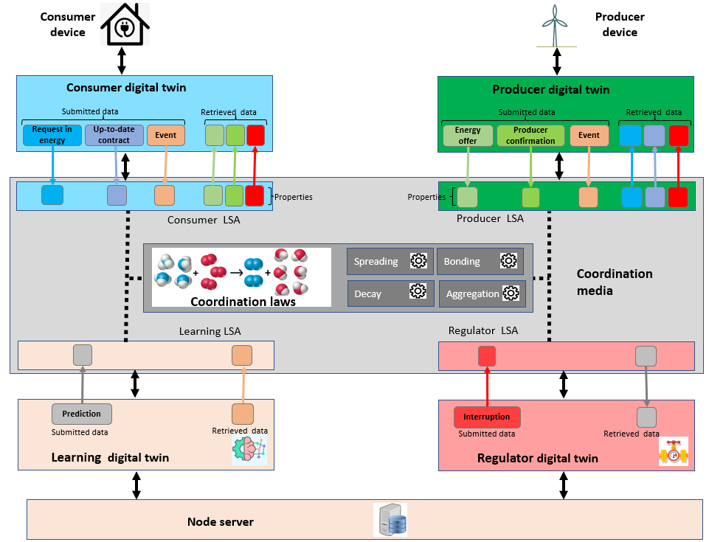
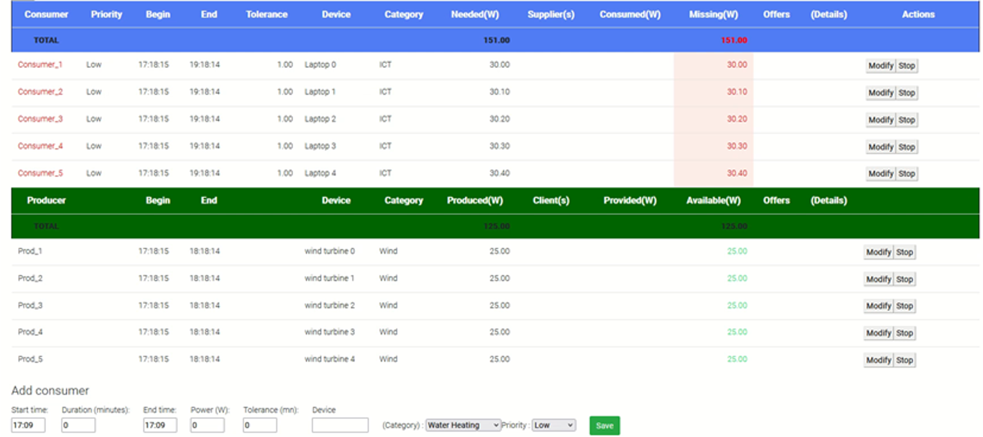
Method: Coordination platform and digital twins
Digital twins: agents' behaviours as
consumer
producer
learning agent
regulator
Agents act autonomously, adapt, organize, and make decisions according to the situation.
Dynamic self-adaptive generation of supply contracts between producers and consumers
Progress report, February 2024

Slide 8
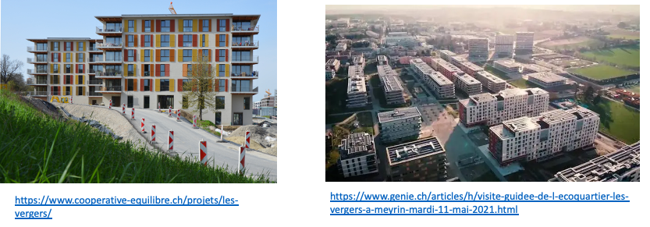
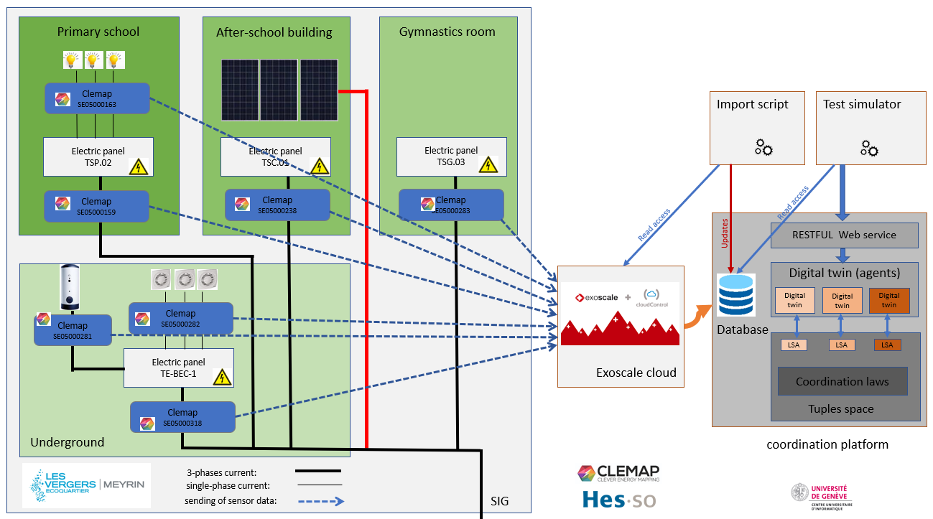
Method: collection of measures data from “Les Vergers” living lab (Meyrin)
Power measurements by smart-meters.
Storage of measurement history.
Progress report, February 2024

Slide 9

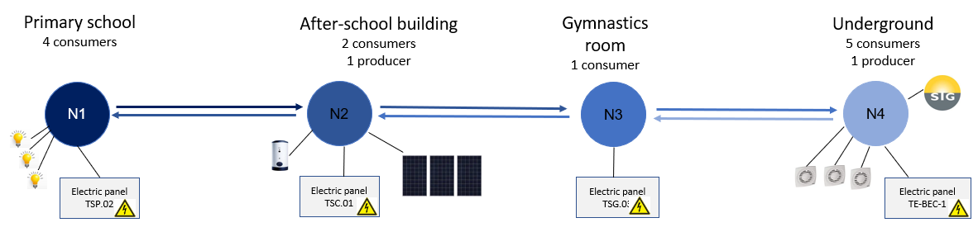
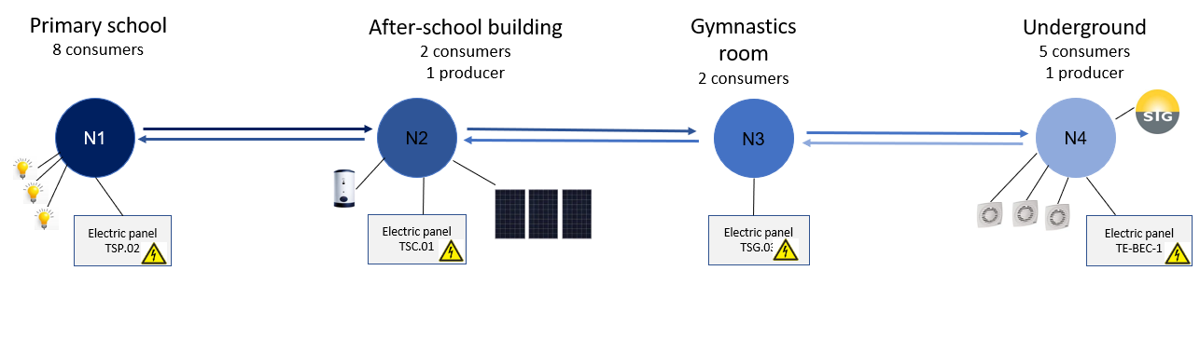
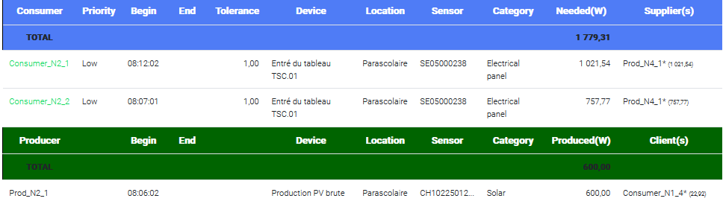
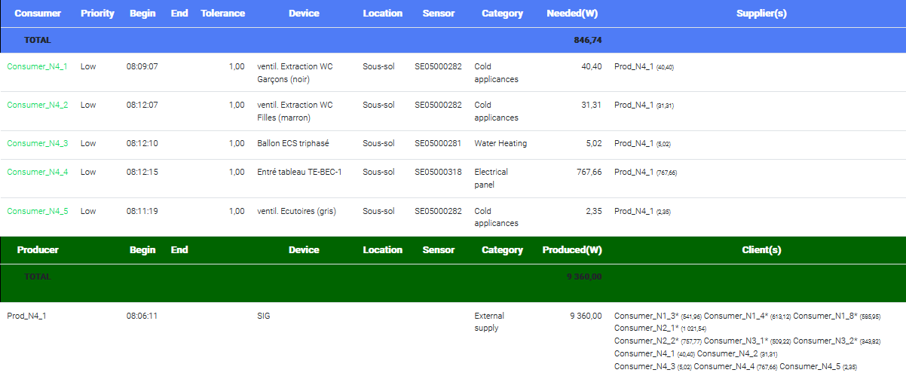
Coordination Platform tuning in a 4-nodes topology
“Chain” topology (1 or 2 neighbours by node)
Progress report, February 2024

Slide 10
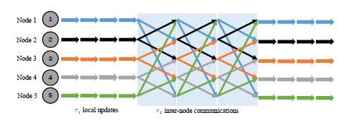
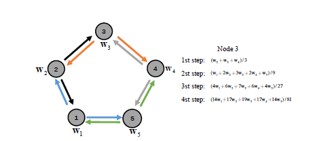
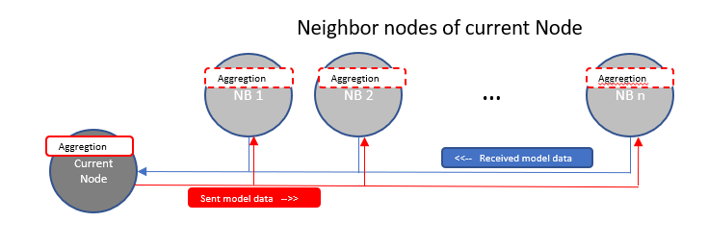
Method : integration of gossip based Federated Learning
Mechanism of Distributed Federated Learning framework:
Use of machine learning at each node level
Fully decentralised
Exchange of model data between nodes
Aggregation of model weights at each node (progressive aggregation)
Independent of Learning Model itself. (Markov chain used in the experimentation)
Wei Liu, Li Chen, and Wenyi Zhang : Decentralized Federated Learning: Balancing
Communication and Computing Costs
Using of Gossip (aggregation + spreading).
Aggregator function defined in the service layer
(customized)
Progress report, February 2024

Slide 11
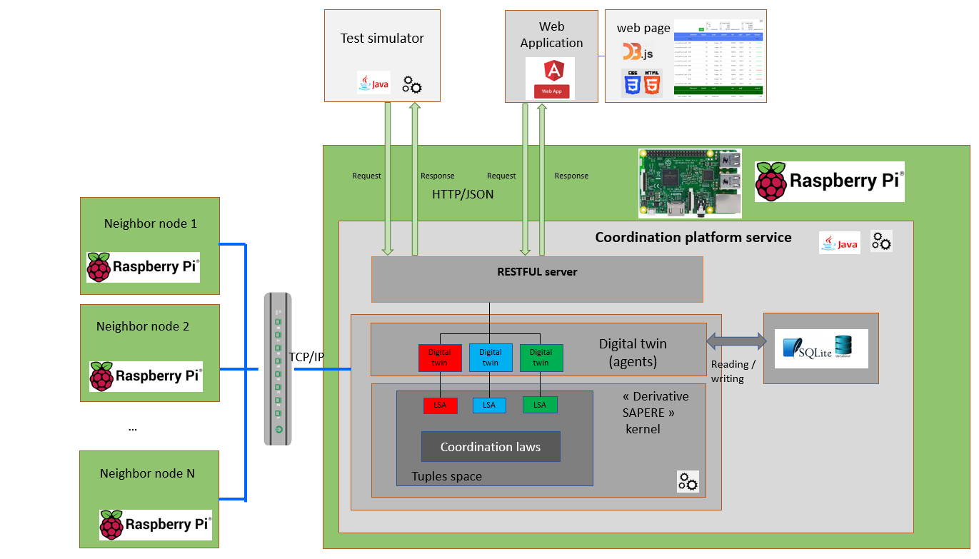
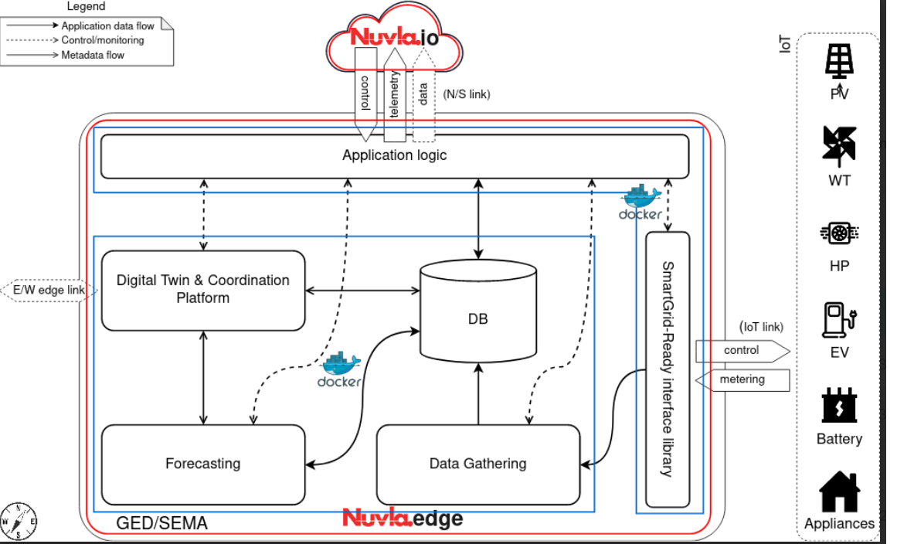

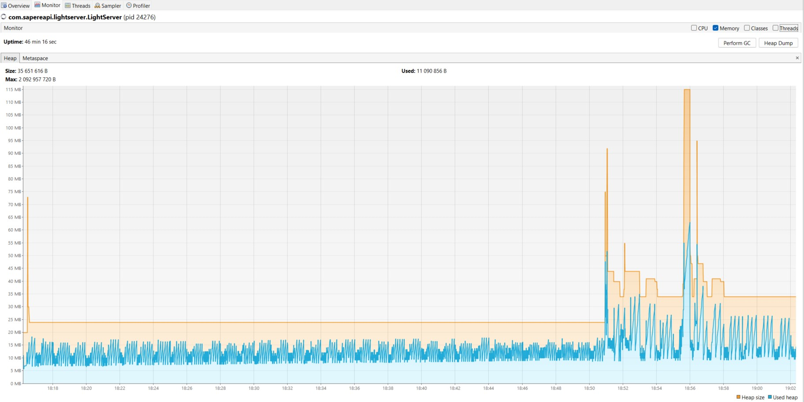


Method: adaption of the platform for Raspberry pi-3
Definition of the target architecture
Monitoring of memory consumption (Visual VM tool)
Deactivation of functionalities not used in a light environment (prediction)
Replacement of spring-boot server by a lighter REST server
Replacement of MariaDB & MongoDB by SQLite3
Building of docker image containing the coordination service jar file
Progress report, February 2024

Slide 12

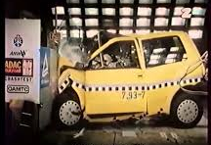

Method: evaluation procedure
Evaluation metrics:
Test scenarios:
Maximal response time to meet demands.
Realist scenario based on consumption statistics.
Ratio of satisfied energy demands.
Real-life scenario (data collected in “Les Verger”).
Fairness of energy distribution.
Crisis scenario:
Over-production/ Over-consumption.
Tragedy of the common.
Shortage.
Urgent demand.
Capability to avoid a predicated event (over-production, shortage).
Network topology:
Single node -vs- 1 node/building
Chain -vs- Full graph
Progress report, February 2024

Slide 13
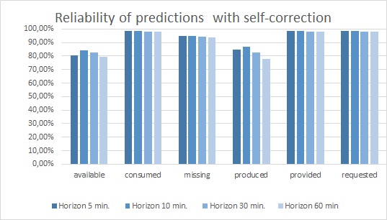
Results
Maximal response time to meet demands for electricity:
Prediction statistics (accuracy):
Progress report, February 2024

Slide 14
Project status: done + ongoing
Item | State of progress | Implemented | evaluated | Revised
 | Defined | Implemented | Evaluated | Revised
Coordination model/platform
Digital twins producer, consumer, learning agent, regulator algorithms for establishing contracts
Light version of the coordination platform that can run on a Raspberry Pi device
Realistic scenarios using statistic data of household consumption
Real-life scenarios using real data from “Les Vergers” Living Lab
Crisis scenarios (1) : over-production/consumption, urgent demand
Crisis scenarios (2) : tragedy of the common, Shortage
Integration of gossip based federated learning using the platform
Integration of social acceptance by design
 | not started |  | on going |  | completed
Progress report, February 2024

Slide 15
Project status: not started yet
Item | Planed start date
Staggering of demand over time when energy availability is not sufficient. | Spring 2024
Modelling of prosumer digital twins. | Summer 2024
Integration of energy pricing and of digital twins' policies regarding pricing. | Autumn 2024
Year 2025
Integration of negotiation between digital twins (peer-to-peer or using an organization such as an auction). | Winter 2025
Integration of energy storage and adapting the behaviour of digital twins for shortage prevention. | Spring 2025
Deployment of the existing solution on CLEMAP devices. | Spring2025
Thesis manuscript | Spring-Summer 2025
Thesis defence | Autumn 2025
Progress report, February 2024

Slide 16
Publications status
Item | Status
Thesis subject. (Validated in October 2023)
Fostering “Energy Communities”: An Ethnographic-SECI Approach to User-Centered Residential Micro-Smart Grid Adoption (11th IEEE INTERNATIONAL CONFERENCE ON SMART GRID, June 2023). https://ieeexplore.ieee.org/document/10171075
Towards a Decentralised Federated Learning Based Compute Continuum Framework” - European Conference on Service-Oriented and Cloud Computing, October 2023. https://link.springer.com/chapter/10.1007/978-3-031-46235-1_14
Coordination Model and Digital Twins for Managing Energy Consumption and Production in a Smart Grid.” November 2023 : https://www.mdpi.com/1996-1073/16/22/7629#
A review of distributed algorithms used in smart-grid digital applications.
Implementation of Gossip Learning framework by using coordination models.
Integration of Social acceptance by design into the algorithm of the Digital Twins.
 | not started |  | on going |  | completed
Progress report, February 2024

Slide 17

Questions
Progress report, February 2024

Slide 18
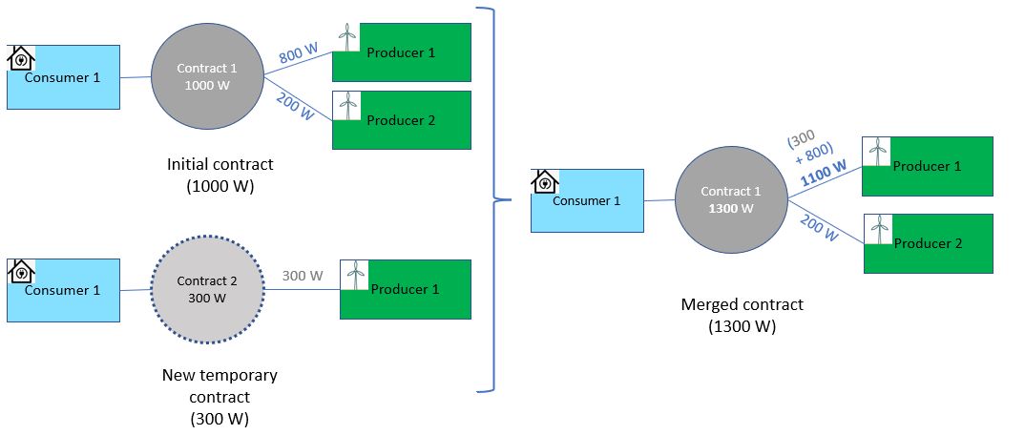
Improvement of the digital twins (done)
Testing of the consumer/producer digital twins by using the data collected from Les Vergers.
Consideration of the fluctuation in demands
Use of a margin in a contract to absorb the power variation
Use of a second « transition contract » when the variation is more important.
Adaptation to meet a growing demand for electricity ( + 300 Watts)
Progress report, February 2024

Slide 19


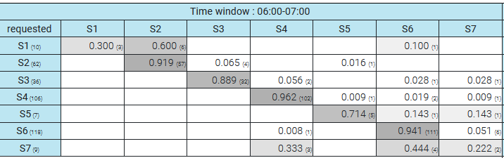
Learning model: use of Markov chains
State of the node
=> 6 variables: wattage demanded, produced, consumed, provided, missing and available
Definition of Markov states
Cutting of the variable space (time slots)
Recording the number of observations
Transition matrix
Progress report, February 2024
19

Slide 20
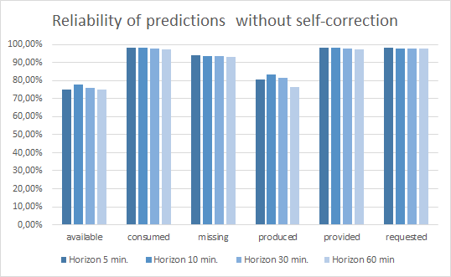
Improvement of the learning model
Training the model using data from Les Vergers
Evaluation of the model by comparing the predicted states with the actual state distribution
Generation of prediction statistics to better understand the difficulties encountered by the model.
Auto-correction mechanism executed by the model.
Progress report, February 2024

Slide 21
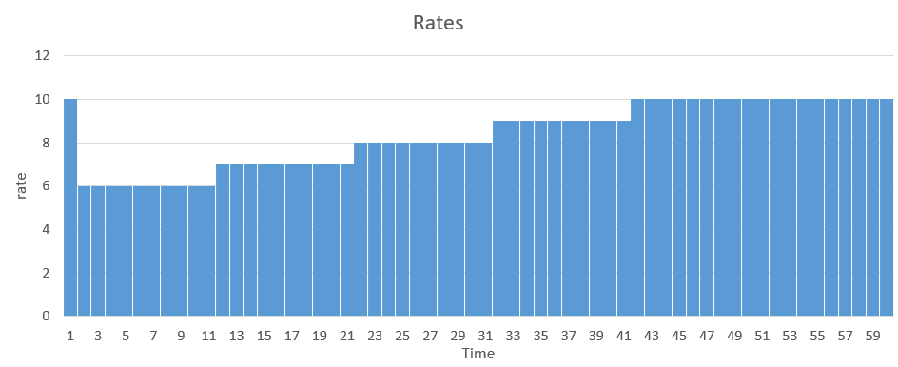
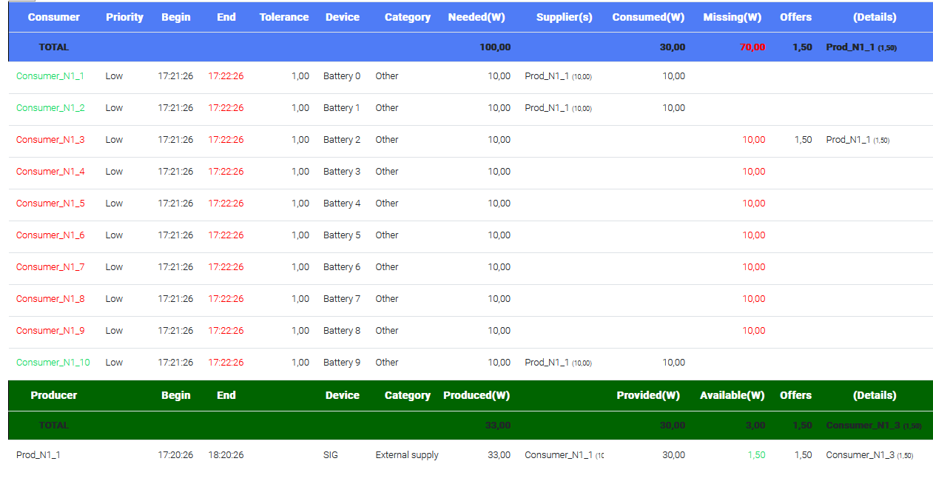
Scenario “Tragedy of the common” (ongoing)
Rates of electricity set by a producer :
Results :
10 demands at the same time (10 x 10 Watts) :
only 3/10 can be satisfied
33 Watts produced
Progress report, February 2024

Slide 22
Methods : evaluation procedure
Ability to provide energy
Evaluation | Synopsis | Measure unit | Conditions | #agents
Response time | Average and maximal response time to respond to the demand in electricity | Seconds
Percentage not provided | Ratio of energy not provided due to poor response times | Ratio in %
Fairness | Fairness of energy distribution
Cost | Cumulated cost of energy
Ability to predict
Evaluation | Synopsis | Measure unit | Conditions | #agents
Model accuracy | Ration of successful predictions | Accuracy ratio in %
Prediction capacity | Capacity of predicting a specified event (over-production, over-consumption, shortage) | Predicted probability in %
Proactive behavior to avoid a crisis
Evaluation | Synopsis | Measure unit | Conditions | #agents
Proactive action | Capacity to avoid a specified event thanks to prediction and the use of self adaptation : over-production, over-consumption, shortage | Boolean (succeed of failed)
Progress report, February 2024

Slide 23
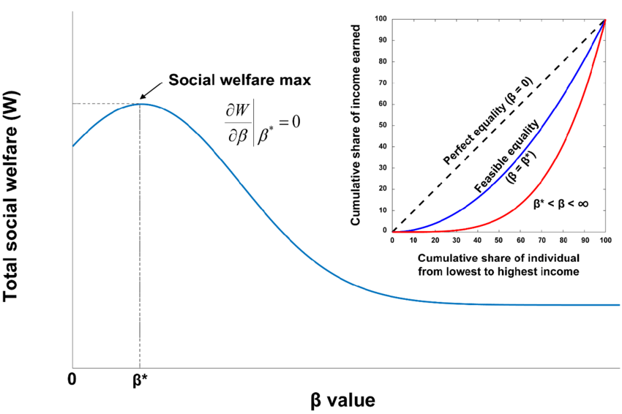

Method : conception & development ⁽⁴⁾
Mechanism of contract/negotiation by integrating criteria of social acceptance
Modeling of individual/social welfare with different criteria
consumption, cost, sustainability, involvement vs free-riding
Modeling of criteria evaluation
Modeling of agent’s utility function
Agent #i : Profile = {λ¹_{i}, λ²_{i}, ….. , λ^{p}_{i}}
Offer: ω
utility: ω -> λ¹_{i}*e¹(ω) + … + λ^{p}_{i} * e^{p}(ω)
U_{i}(ω)
Modeling of negotiation bilateral negotiation
Modeling of organized market (auctions)
Progress report, February 2024

